Slide 1


Student management system micro it diya saini

Slide 2




introduction
A Student Management System (SMS) is a software application designed to automate and streamline the management of student data, records, and processes within an educational institution. It aims to improve efficiency, accuracy, and communication while simplifying administrative tasks. The system typically manages various aspects of a student's educational journey, from enrollment to graduation, including registration, attendance, grades, assessments, and more.
This Photo by Unknown Author is licensed under CC BY-SA
This Photo by Unknown Author is licensed under CC BY

Slide 3
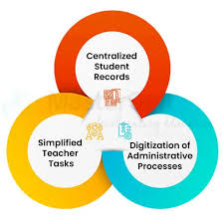
OBJECTIVE
A Student Management System (SMS) aims to streamline and automate administrative tasks related to students, improving efficiency and organization within educational institutions. Key objectives include managing student data, facilitating communication, and improving overall operational efficiency.

Slide 4

System design
A Python-based student management system project design would typically involve creating a GUI using Tkinter, connecting to a database (like MySQL or SQLite), and implementing functions for managing student data. The system architecture would involve a client-side (GUI) built with Tkinter and a backend (database interaction) using Python
User Interface Elements:
Frames: Organize the interface into logical sections.
Widgets: Labels, text entry fields, buttons, list boxes, etc.
Events: Handle user actions (e.g., button clicks, text entry).

Slide 5

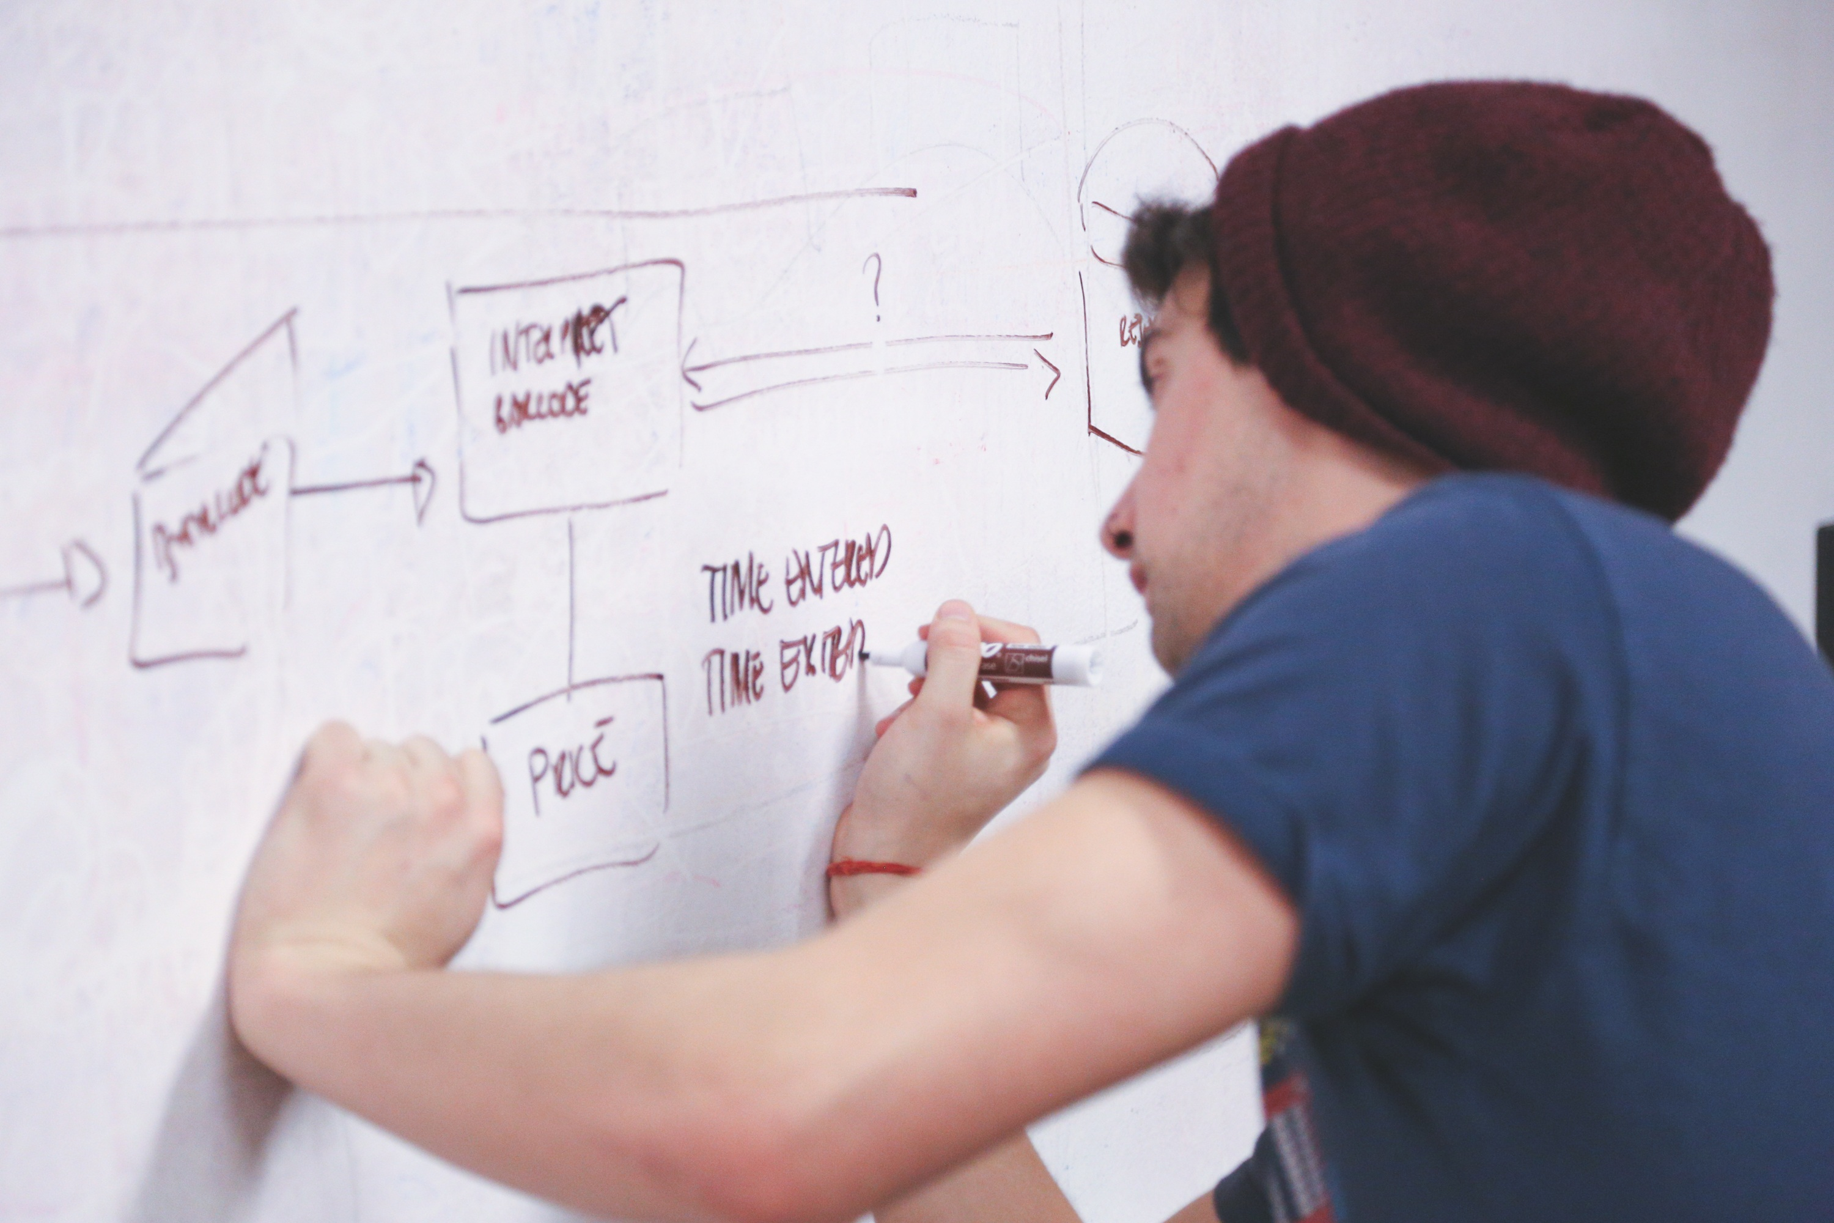
Key features
Student Registration: Allowing users to add new student records.
Data Display: Presenting student information in a clear and organized way.
Data Update: Enabling users to modify existing student data
Data Deletion: Removing student records from the database.

Slide 6
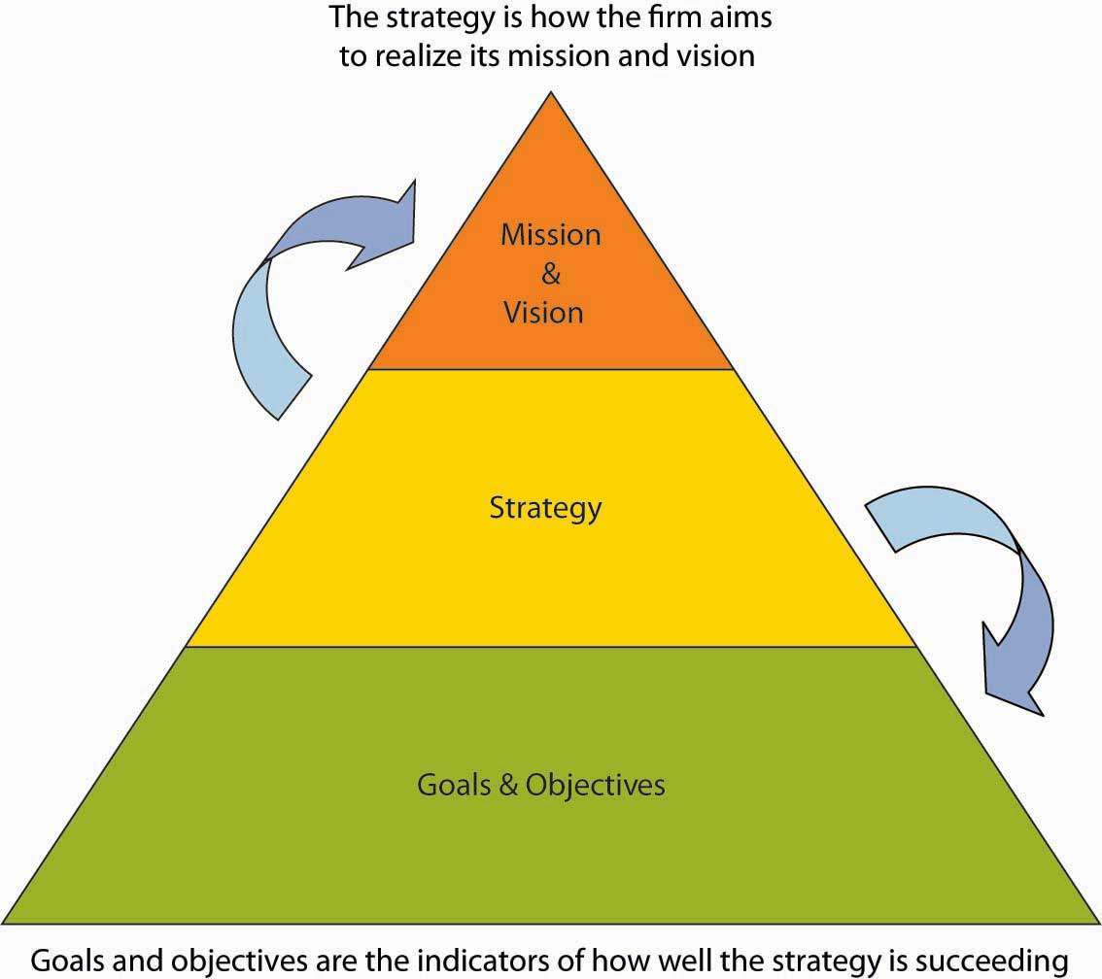
Project Prerequisites
To build this project, we will need the following libraries:
1. Tkinter – To create the GUI. 2. SQLite3 – To connect the program to the database and store information in it. 3. TkCalender – To get the user to enter a date. 4. Datetime.date – To convert the date from the tree to a Datetime.date instance so that it can be set in. 5. Tkinter.messagebox – To show a display box, displaying some information or an error. 6. Tkinter.ttk – To create the tree where all the information will be displayed.

Slide 7

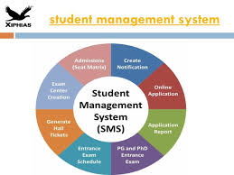
main components
1. Graphical User Interface (GUI):
Libraries like Tkinter are used to create a user-friendly interface for interacting with the system.
The GUI allows users to add, edit, delete, and search student records.
2. Database Management:
A database (like SQLite) is used to store and manage student data.
Libraries like sqlite3 facilitate interaction with the database.
3. Core Functionalities:
Add Student: Allows administrators to enter new student records into the database.
Update Student: Enables modification of existing student records.

Slide 8
Code structure
OUTPUT
1. main.py
This is the entry point of your application.
It only calls the menu system to start the user interface.
--- Student Management System ---
1. Add Student
2. List Students
3. Find Student
4. Delete Student
5. Exit
Enter choice:
2. student.py
Defines a Student class, representing a student record.
Attributes like:
student_id name grade age
3. database.py
Responsible for data storage.
Uses a JSON file (students.json) to store student data.
Has two functions:
load_students() – Reads student records from the file.
save_students() – Writes student records to the file.

Slide 9

LEARNING OUTCOMES
1. Understanding Python Basics
Use of variables, loops, conditionals, and functions
2. Modular Programming
Breaking code into multiple files/modules:
3. File Handling & Data Persistence
Reading and writing data to a file
4. Object-Oriented Programming (OOP)
Creating and using classes and objects
5. Command-Line Interface (CLI) Design
Designing simple and user-friendly text menus
Handling user input and displaying outputs
This Photo by Unknown Author is licensed under CC BY-NC

Slide 10

conclusion
The Student Management System project in Python is a valuable learning experience for beginners and intermediate programmers, offering practical exposure to core programming concepts. Through this project, you gain hands-on experience with object-oriented programming by creating and managing student data using classes and objects. The code is structured modularly maintainable development practices by separating data model, file storage, and user interface into distinct components. You also learn to implement essential CRUD (Create, Read, Update, Delete) operations and store data persistently using JSON files. The command-line interface teaches you how to interact with users effectively through input prompts and menus. Overall, this project not only reinforces your understanding of Python syntax and structure but also prepares you for more complex applications.

Slide 11

Future scope
🔗 Integration with a Real Database
Replace JSON file storage with a relational database like SQLite, MySQL, or PostgreSQL for better data management, scalability, and performance.
🖥️ Graphical User Interface (GUI)
Makes the system accessible to non-technical users like teachers or school admins.
🌐 Web-Based Version
Allows users to access the system from any device via a browser.
🛡️ User Authentication and Roles
Add login.
Define user roles (admin, teacher, student) with different permissions.
📱 Mobile App Integration
🧠 AI & Automation

Slide 12

Thank You

